Slide 1
Factors affecting customers' acceptance of personal loans
Present by Nguyen Quoc Buu
Jun 7th 2023

Slide 2


Presentation Outline
1/ Overview of Dataset and Question
2/ Descriptive Statistics and Correlation Analysis Data
3/ EDA Personal Loan acceptance
4/ Feature Importance
5/ Build model to predict personal loan accept
6/ Conclusion/ Discussion

Slide 3
Overview of Dataset and Question
This dataset has 5000 entries and 14 columns and Personal Loan is target.
The data include customer demographic information (age, income, etc.), the customer's transaction with the bank (mortgage, securities account, etc.), and the customer's acceptance of the personal loan last year.
What are the factors that influence customers to accept personal loans?
Help the bank manager and retail marketing increase personal loans acceptance.

Slide 4
Descriptive Statistics
Summary describes
Age, Experience, Income, CCAvg, Mortgage are numerical variables.
Personal loan, Securities Account, CD Account, Online, Credit Card are categorical variables.
Customer age ranges from 23 to 67; average age is 45; maximum customer experience is 43 years.
Customer income from 8000 to 98000 per year, family size from 1 to 4 members.
Education level and family size

Slide 5
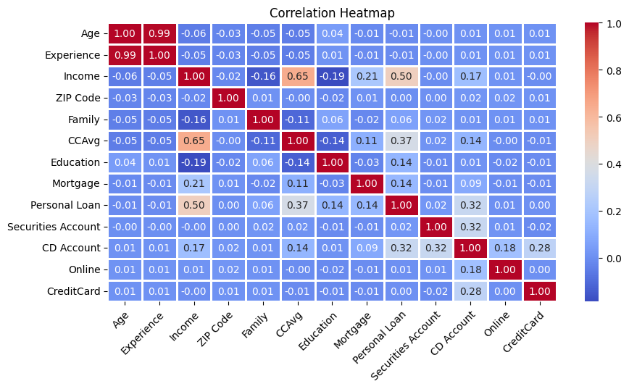
Explore the correlation Personal Loan and other features in the dataset
Income' and 'CCAvg' is moderately correlated
Acceptance of personal loans has maximum correlation with feature Income, average spending on credit cards per month, mortgage, education.

Slide 6
Exploratory Data Analysis (EDA) the factors that influence customers to accept personal loans
1. Distribution of Personal Loan
2.Visualize the distribution of Age, Experience, Income, Family size, CCAvg-average spending on credit cards per month and Mortgage
3. Categorical Analysis: Education, Securities Account, CD Account, Online, Credit Card
4. Analysis education and family size affect personal loan acceptance
5. Income and Age group affect personal loan acceptance
6. Correlation Analysis: Income and CCAvg to Personal Loan acceptance
7. Personal Loans by County

Slide 7
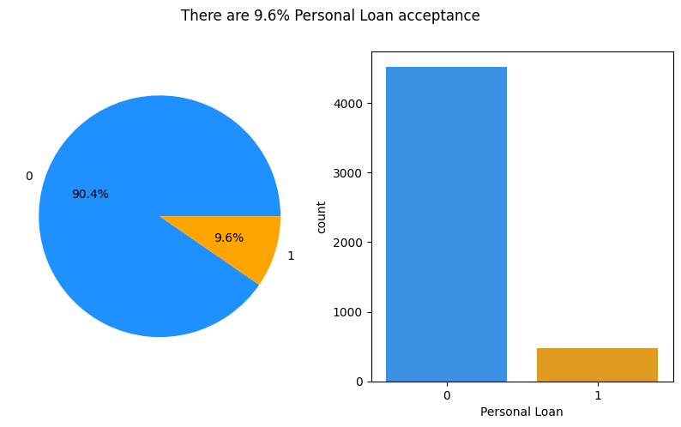
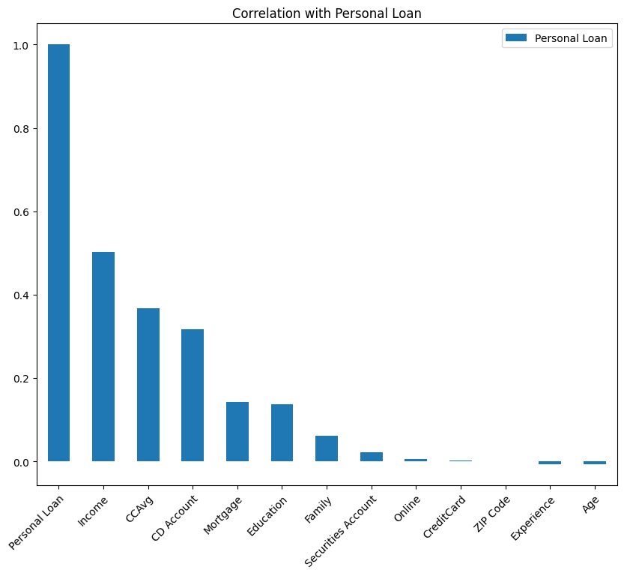
Exploratory Data Analysis (EDA) Distribution of Personal Loan

Slide 8
Exploratory Data Analysis (EDA) Distribution of Personal Loan
Personal Loan | 0 | 1
Age | 45.367257 | 45.066667
Experience | 20.132301 | 19.843750
Income | 66.237389 | 144.745833
ZIP Code | 93152.428761 | 93153.202083
Family | 2.373451 | 2.612500
CCAvg | 1.729009 | 3.905354
Education | 1.843584 | 2.233333
Mortgage | 51.789381 | 100.845833
Securities Account | 0.102212 | 0.125000
CD Account | 0.035841 | 0.291667
Online | 0.595796 | 0.606250
CreditCard | 0.293584 | 0.297917
People with personal loans earn more than twice as much as those without personal loans.
Average spending on credit card bills is higher for personal loan takers.
The mortgage value is also double that of people who took personal loans.

Slide 9
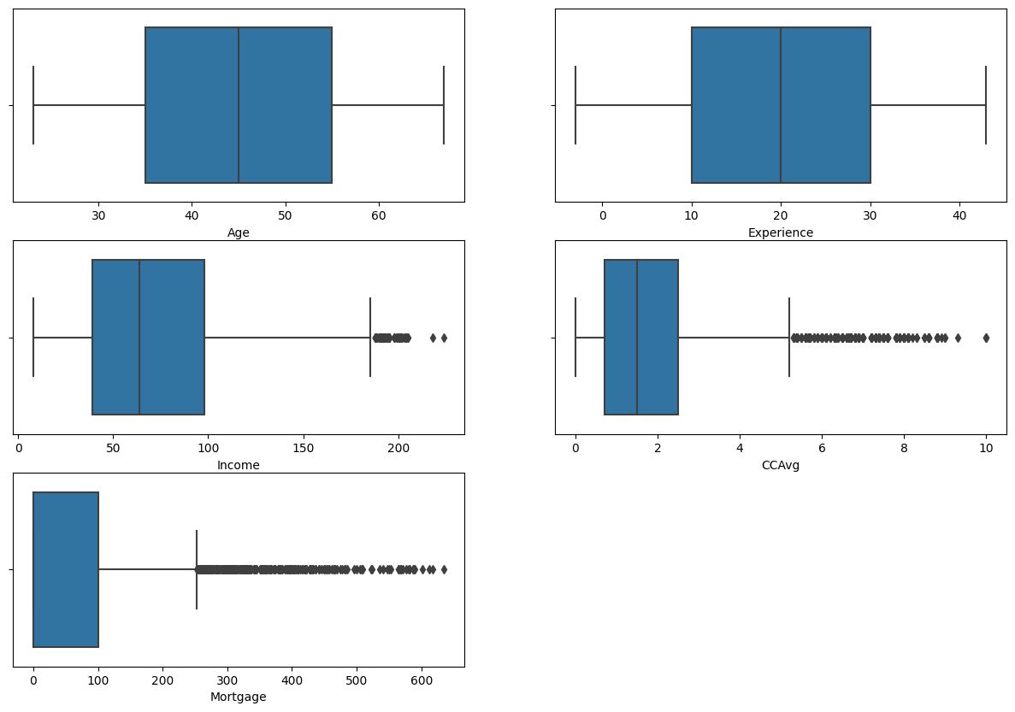
Exploratory Data Analysis (EDA) Visualize the distribution
-Age distribution from 35-55 years
-Experience distribution from 10 -30 years
-Income distribution from 39-98.00USD
-CCAvg distribution from 700 -2.500USD
-Mortgage distribution from 0 -101.000USD

Slide 10
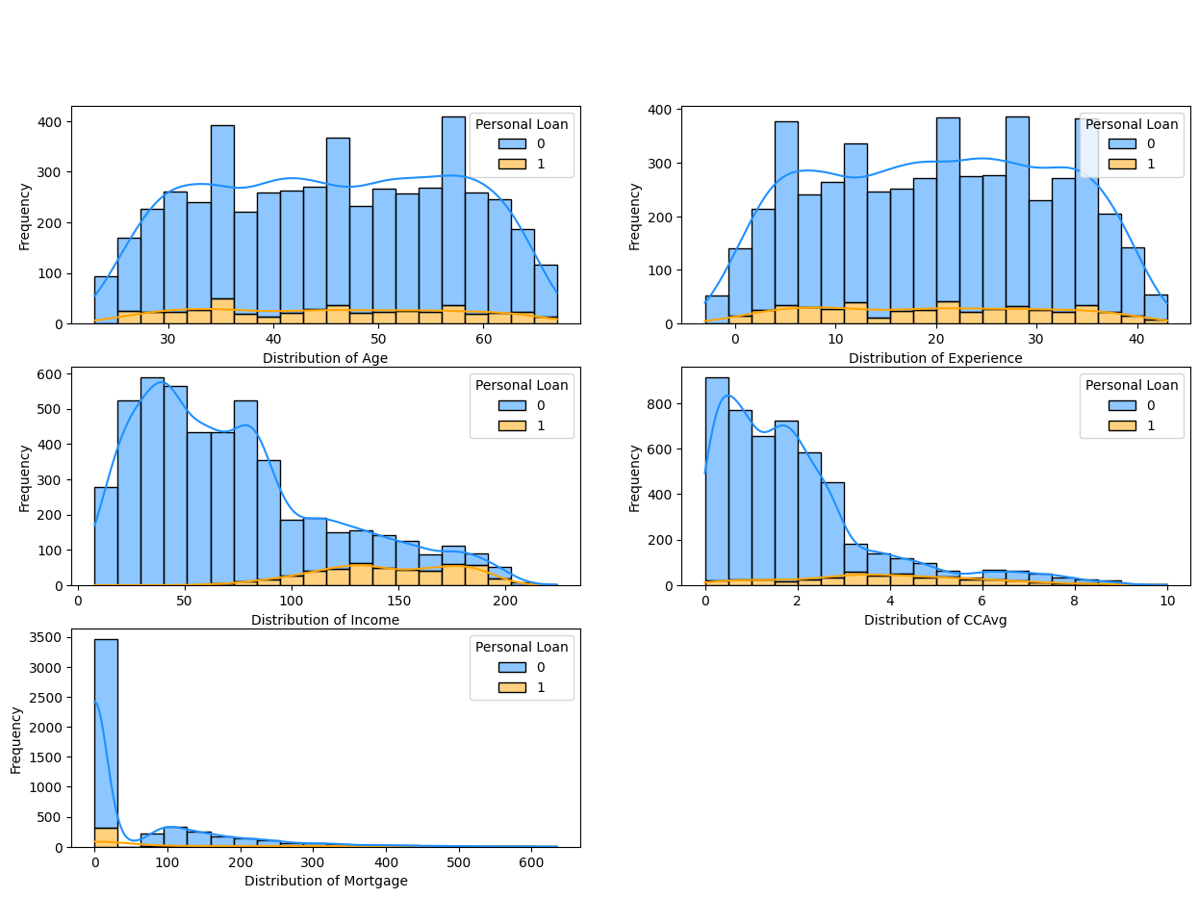
Exploratory Data Analysis (EDA)
- Age and Experience have normal distributions
- Customers with High Income have more chances of having Personal Loan.
- The customer who took the personal loan has a low CCAvg.
- The Mortgage have more chances of customer having Personal Loan.

Slide 11
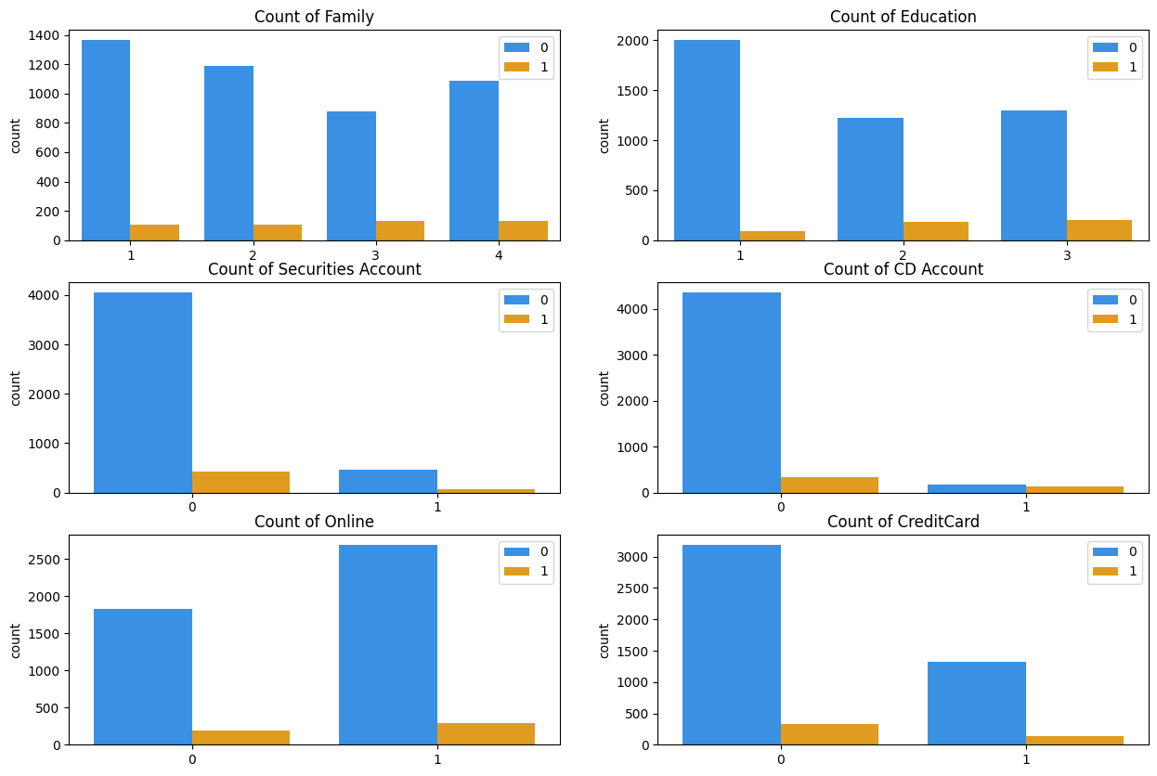
Exploratory Data Analysis (EDA) Visualize the distribution of Age, Experience, Income, Family, Mortgage
Categorical Analysis: Education, Securities Account, CD Account, Online, Credit Card

Slide 12
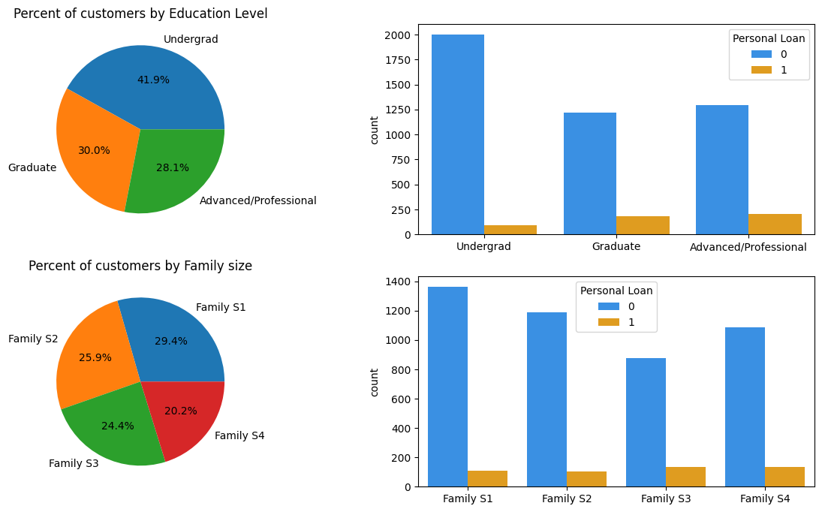
Exploratory Data Analysis (EDA) Visualize the distribution of Age, Experience, Income, Family, Mortgage
Exploratory Data Analysis (EDA)

Slide 13
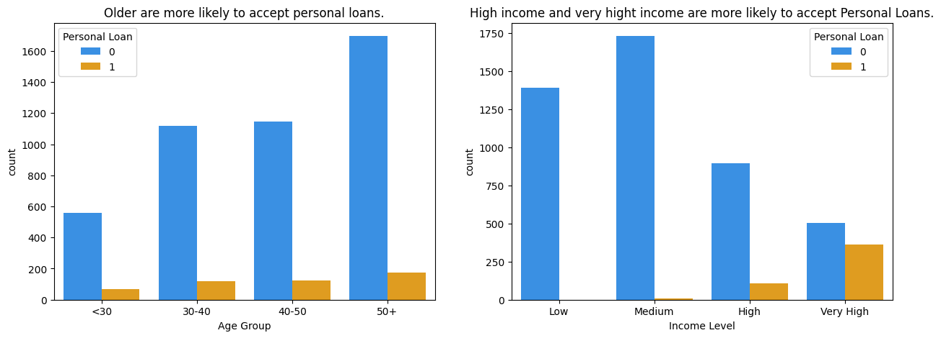
Exploratory Data Analysis (EDA) Visualize the distribution of Age, Experience, Income, Family, Mortgage
EDA level of income and age group affect personal loan acceptance
Income_Level = [Low <=40.000, 40.000< Medium <=80.000,
80.000< High <=120.000 , Very High >120.000]

Slide 14
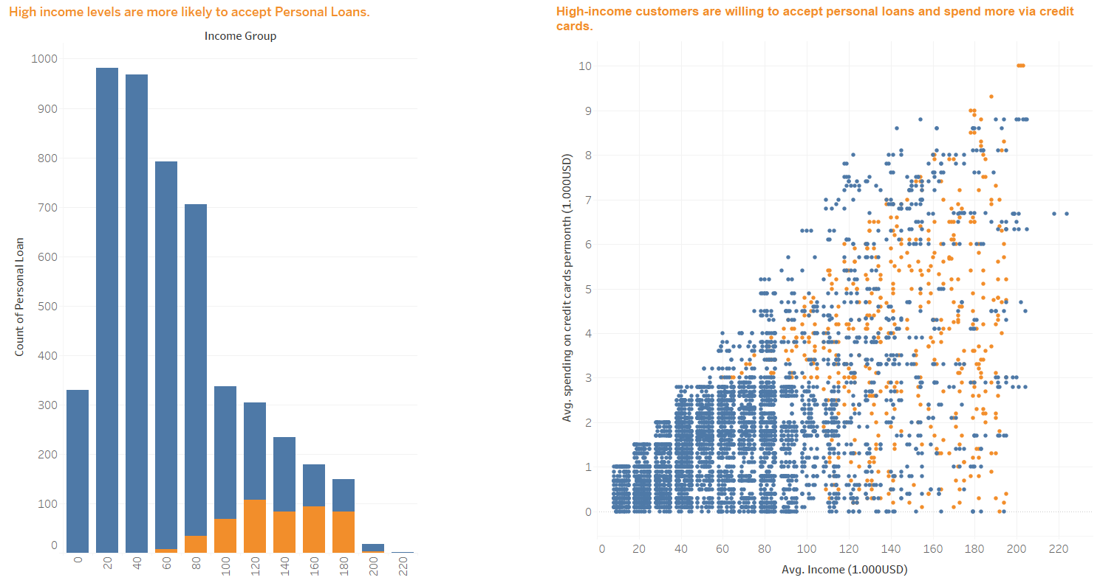
Exploratory Data Analysis (EDA) Correlation Analysis: Income and CCAvg to Personal Loan acceptance

Slide 15
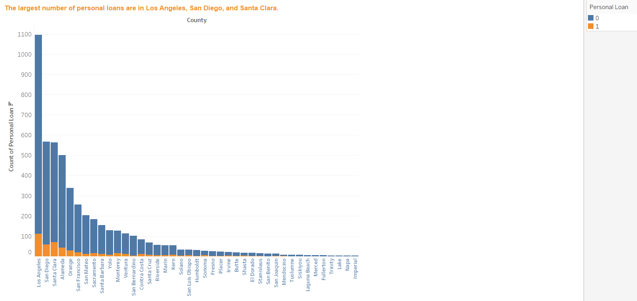
Exploratory Data Analysis (EDA) Personal Loans by County

Slide 16
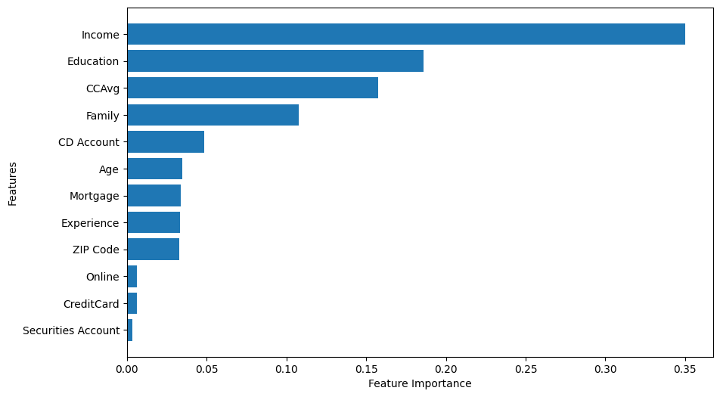
Feature Importance Determine the importance of each feature in predicting the personal loan outcome
(using the Random Forest model)

Slide 17
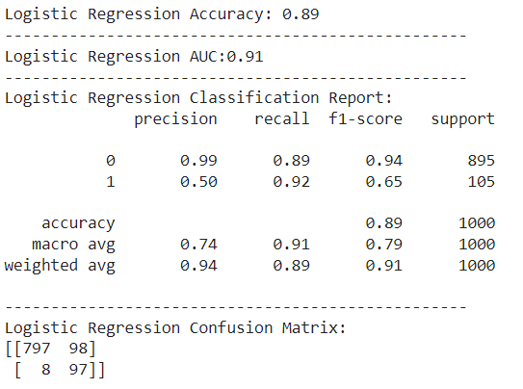
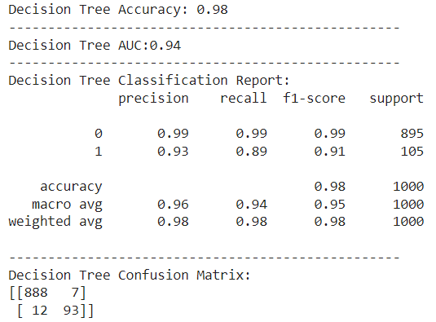
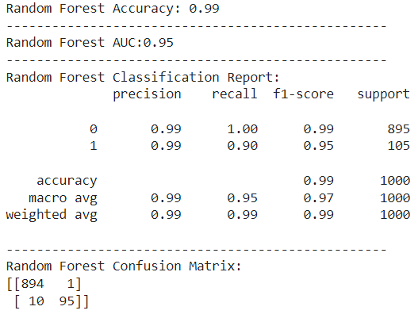
Build model to predict personal loan accept

Slide 18
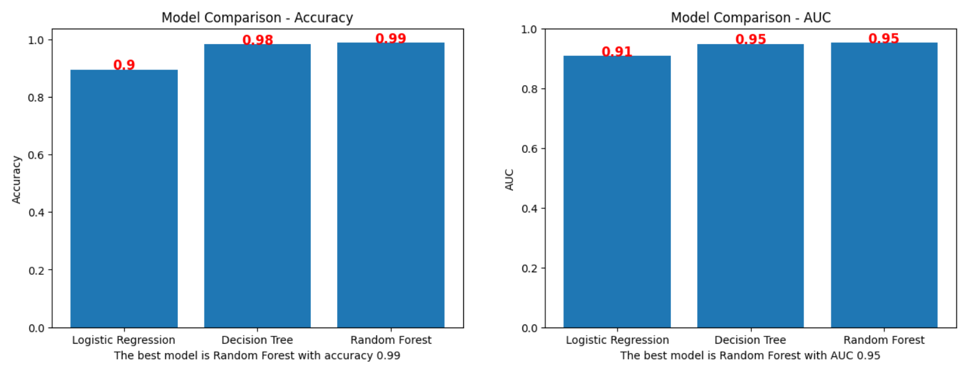
Find the model with the highest accuracy/auc

Slide 19
Conclusion
1/ Customers accepting personal loans have double the income, double the mortgage value, and double the average spending on credit cards per month.
2/ Customers with High Income and Mortgage value have more chances of having Personal Loan.
3/ Customers with higher education tend to borrow personal loan.
4/Older are more likely to accept personal loans.
5/ The largest number of personal loans are in Los Angeles, San Diego, and Santa Clara.
6/ Acceptance of personal loans has maximum correlation with feature: Income, CCAvg, CD Account, mortgage value and Education level.
7/ Feature Importance (using Random Forest): Income, Education level, CCAvg, Family, CD Account
8/The best model is: Random Forest with accuracy 0.98 and AUC 0.95

Slide 20
Thanks for your attention!

